Slide 1
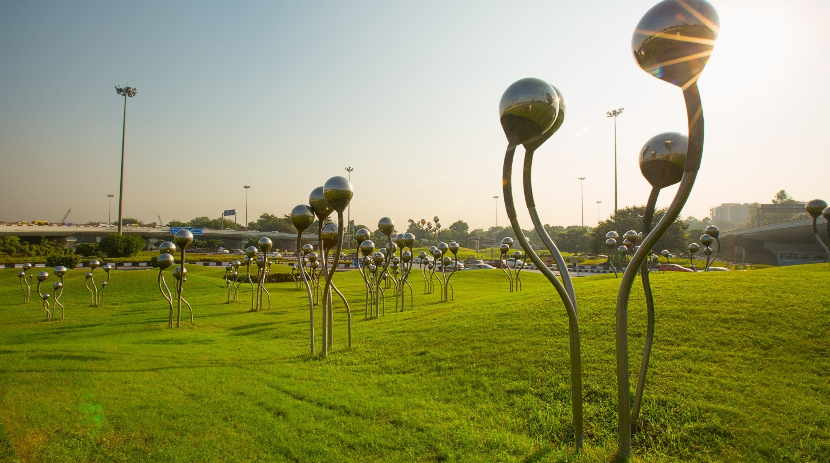

Making Bharat Atmanirbhar Since 1970
1

Slide 2
DCOE (Digital Centre of Excellence)
Project 3: DCOE(Digital Centre of excellence) to be completed by 31th Aug 26
Section | Crisp Update (Quantified & Professional)
Project Objective | Establish a centralized platform to manage, govern, and monitor digital initiatives across all plant locations from idea to enterprise-wide deployment.
Earlier Process (Manual) | Digital initiatives were managed through emails and spreadsheets with manual approvals, fragmented tracking, and no centralized repository.
Current Process (AI-Enabled) | A centralized workflow-driven platform automates idea submission, approvals, cost tracking, PR/PO management, project execution, UAT, Go-Live, and knowledge sharing.
Efficiency Gain | Reduces manual effort, accelerates approvals, improves project visibility, and standardizes initiative management across all plants.
Benefits Overview
Tangible Benefits | Non-Tangible Benefits | Elevated Benefits (Strategic Impact)
Improves project execution efficiency through faster approvals, centralized cost and procurement tracking, reduced duplication of initiatives, better resource utilization, organized documentation, and measurable tracking of savings and return on investment (ROI). | Enhances collaboration among plants and departments, strengthens governance and accountability, promotes innovation through structured idea management, improves knowledge sharing, and fosters a culture of continuous digital transformation. | Establishes a scalable enterprise-wide digital governance framework that accelerates Industry 4.0 initiatives, enables rapid horizontal deployment of successful solutions, supports strategic decision-making through centralized analytics, and drives long-term operational excellence across the organization.

